Slide 1
Project Management Ms. Maryam Farooq

Slide 2
Text and References
Effective Project Management
by Robert K. Wysoki et al.
Project Management for Business and Technology
by John M. Nicholas
PMBOK® Guide
by Project Management Institute
Management: A Global & Entrepreneurial Perspective
by Heinz Weihrich et al.

Slide 3

What is a Project?
“A Project is a sequence of unique, complex
and connected activities having one goal or
purpose and that must be completed by a
specified time, within budget and according
to specifications.”

Slide 4
What is a Project?(Business Focused Definition)
Satisfaction of the client is in value of the deliverable
“A project is a sequence of finite dependent activities whose successful completion results in delivery of expected business value that validates doing the project.”

Slide 5
Project Vs. Operations
Project | Operations
One time /temporary | Ongoing
Unique | Repititive
Use of wide variety of skills | Limited skills
Use of special purpose equipment for short duration | equipment are in continuous use

Slide 6
Properties of a Project
Goal orientation
Coordinated undertaking of interrelated activities
Finite durations with clear beginning and end
Certain degree of uniqueness

Slide 7
Project Examples
Civil Construction
Product Development
Launching a Satellite
Software Development
Annual Maintenance
Installation of Computer System
Arranging Conference

Slide 8
Management
Getting work done with or through people
Managing resources efficiently and effectively
“The task of planning, coordinating, motivating and controlling the efforts of other towards specific objectives.”

Slide 9
Project Management
The discipline of planning, organizing, securing and managing resources to bring about the successful completion of specific project goals and objectives.

Slide 10
Main Problems
Scope Creep Hope Creep
Feature Creep Effort Creep

Slide 11
Scope Creep
Change in the project that was not in the
original plan, initiated by the owner

Slide 12
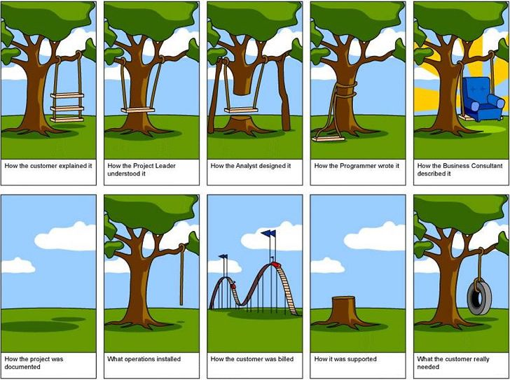

Slide 13

Hope Creep
Project team member getting behind
schedule, reporting to be on schedule,
hoping to catch up by the next report date

Slide 14
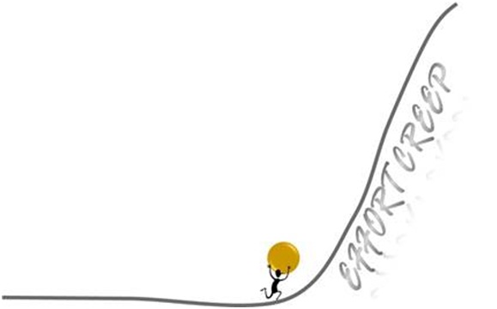
Effort Creep
Team member is working but not making
progress proportionate to the work
expended

Slide 15
Feature Creep
Team members arbitrarily add features to the deliverable

Slide 16
Taxonomy of projects
Activity- industrial/ non industrial
Location- regional, national, international
Time – normal , crash
Ownership – sole, partnership, joint stock
Size – small , medium, large
Need
New project
Expansion
Diversification
Integration

Slide 17
Types of Projects Based upon Durations
Type | Duration | Risk | Complexity | Technology | Likelihood of problems
A | > 18 months | High | High | Breakthrough | Certain
B | 9-18 months | Medium | Medium | Current | Likely
C | 3-9 months | Low | Low | Best of breed | Some
D | < 3 months | Very low | Very low | Practical | none

Slide 18
Types of Projects Based upon Risk/Value
High risk | 4 | 3
Low risk | 1 | 2
 | Low business value | High business value

Slide 19
Jazak Allah

Slide 20
Process groups

Slide 21
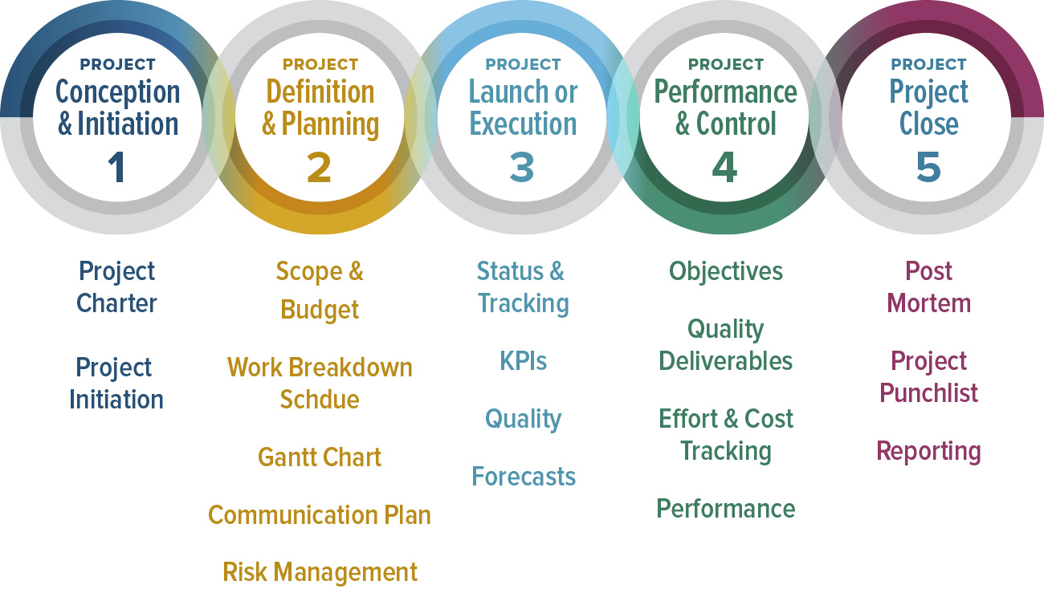

Slide 22
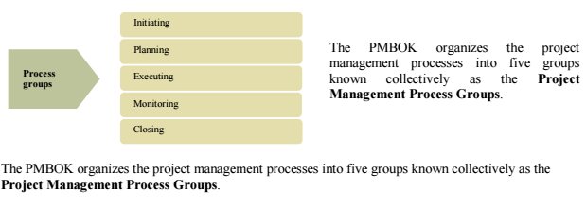
Process groups

Slide 23
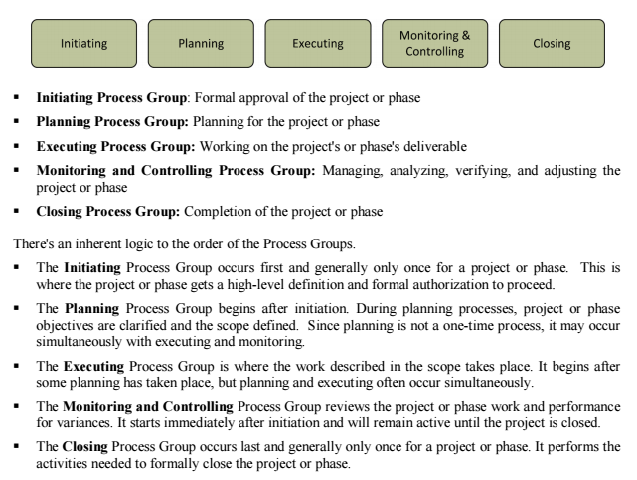
Process groups

Slide 24
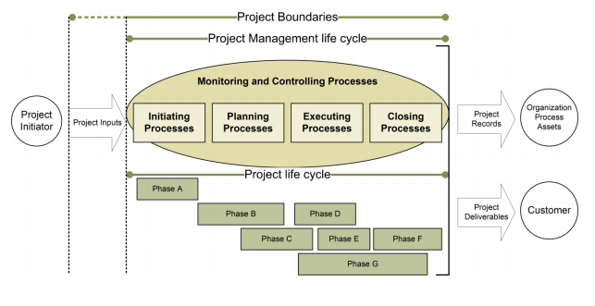
Process groups

Slide 25
Project Phases
1. Initiating
2. Planning
3. Implementation
4. Controlling
5. Closing

Slide 26
Initiating
Eliciting clients’ needs
Documenting client’s needs
Negotiating how these needs will be met
POS
Problem/Opportunity
Goal
Objectives
Success Criteria
Assumptions, Risks & Obstacles
Attachments
Gaining senior management approval

Slide 27
Planning
WBS
Duration
Resource Requirements
Network Analysis
Proposal

Slide 28
Implementation
Team Organization
Resource Leveling
Work package scheduling
Work package documentation

Slide 29
Controlling
Progress reporting system
Monitoring
Comparing
Adjusting

Slide 30
Closing
Client Acceptance
Documentation
Audit
Final Report
Celebration

Slide 31
PROJECT OBJECTIVES
Project Objectives
Quality
Risk
Resource
Budget
PM about to maintain balance
Schedule
Expectation
Personnel

Slide 32
CHARACTERISTICS OF PROJECT MANAGEMENT
Defining characteristics of a project:
It has starting and ending points;
It is performed by one or any number of people;
It has constraints on time, money, or other resources;
It is progressively planned, controlled, and executed;
It results in a unique product, service, or result for the enterprise.

Slide 33
Life cycles
Life cycles
Product
Project
The product life cycle compasses all the activities related to a product from inception until it is divested. This might include research and development, feasibility studies, product development, enhancements, training, upgrades, and ongoing maintenance. Even intangible products, like services or results, follow a similar generic life cycle.
Inception/ Incubation | Development | Growth | Maturity/ Maintenance | Decline

Slide 34
Life cycles
Life cycles
Product
Project
The project life cycle is one element of the product life cycle since there are normally many projects involved
over a product’s life span. The project life cycle encompasses only those activities related to the project‘s purpose.
Project X
Phase A | Phase B | Phase C | Phase D | Phase E
These project activities are categorized into phases, which collectively make up the project life cycle. These phases connect the start of the project to the end of the project, and are generally sequential,

Slide 35
Life cycles
Costs and staffing levels are lowest early in the life cycle, peak while the project work is underway, and then drop off as the project nears completion.
Risk is highest early in the project since uncertainty is high about the project’s deliverables, resource needs, and work required. And all this uncertainty means that a project is most likely to fail early in its life
cycle.

Slide 36
stakeholders
Stakeholders is a very broad category of people, and it includes everyone involved and negatively or positively affected by the project. It can include users, consumers, departments, groups, managers, organizations, unions, companies, and even communities.
Stakeholders are sometimes subcategorized into other groups, such as:
Key Stakeholders: Those who have significant decision-making involvement in the project or with the activity taking place. Customers are key stakeholders.
Primary Stakeholders: Those who are directly impacted by the project’s objective or through one or more of its deliverables.
Secondary Stakeholders: Those who are only indirectly affected by the project’s objective or through one or more of its deliverables.

Slide 37
Jazak Allah

